Slide 1
Measuring the Similarity Between Implicit Semantic Relations from the Web
Bollegala, D.; Matsuo, Y.; Ishizuka, M. (University of Tokyo)
André Kenji Horie (M1)

Slide 2
Agenda
Introduction
Proposed Method
  Retrieving Contexts
  Extracting Lexical Patterns
  Identifying Semantic Relations
  Measuring Relational Similarity
Experiments
  Relation Classification
  SAT Word-Analogy Questions
Conclusion

Slide 3
Introduction

Slide 4


What is Attributional Similarity?
A high degree of attributional similarity exist between lion and cat: sim(X, Y)
Mammal, family Felidae
Four legs
Mammal, family Felidae
Four legs

Slide 5


What is Relational Similarity?
A high degree of relational similarity exist between the two object pairs: sim(A, B, X, Y)
Lion is a large cat
Ostrich is a large bird
Notes:
High degree of attributional similarity: Synonymous ideas
High degree of relational similarity: Analogous ideas

Slide 6
Application
Recognizing analogies:
  Ex.: (traffic, road) vs. (water, pipe) → “X flows in Y”
Semantic relation classification
  Classifying noun modifiers
  Ex.: Laser printer (instrument), concert hall (purpose), student discount (beneficiary)
Search using implicitly stated analogies
  Ex.: “Muslim Church” should return “mosque”

Slide 7
Analogy making in AI
Structure Mapping Theory (SMT):
  Analogy is a mapping of knowledge from one domain (base) to another (target), conveying that a system of relations known to hold in the base also hold in the target
Mapping rules:
  Attributes of objects are dropped
    RED (b_{i}) → RED (t_{i})
  Certain relations between objects in the base are mapped to the target
    REVOLVES (Earth, Sun) → REVOLVES (Electron, Nucleus)
Notes:
SMT only maps relations, not attributes

Slide 8
Proposed Method

Slide 9
Overview
How to explicitly state the relation between two entities?
How to extract the multiple relations between two entities?
  Extract lexical patterns from contexts where the two entities occur
A single semantic relation can be expressed by multiple patterns
  Cluster the semantically related patterns into separate clusters
Semantic relations might not be independent
  Measure the correlation between various semantic relations
The contribution of different semantic relations towards relational similarity is unknown
  Learn the contribution of different semantic relations using training data (supervised approach)
Notes:
3- Ex.: ACQUISITION – X acquires Y, Y is bought by X
4- Ex.: Ostrich is a bird AND Ostrich has feather – These relations are dependent (a bird has feathers)

Slide 10
Retrieving Contexts
Text snippets from a Web search engine
Queries:
“… lion, a large heavy-built social cat of open rocks in Africa…”
Queries are not independent
  Same results but different rankings
Remove duplicate search results
“A * B” | “A * * B” | “A * * * B” | A B
“B * A” | “B * * A” | “B * * * A”
Notes:
Retrieving text snippets from a web search engine is computationally efficient.
Dependent queries: Since only top results are downloadable, multiple queries induce different rankings.
Duplicate search results: Pages can be mirrored; Default de-duplication algorithm of a search engine may fail

Slide 11
Extracting Lexical Patterns
Use prefix-span, a sequential pattern mining algorithm, to generate subsequences
  “… lion, a large heavy-built social cat of open rocks in Africa…”
  becomes: X, a large Y / X a Y / X a large Y of
Why prefix-span?
  It is efficient
  It can consider gaps
Extracted patterns can be noisy:
  Misspellings, ungrammatical sentences, fragmented snippets

Slide 12
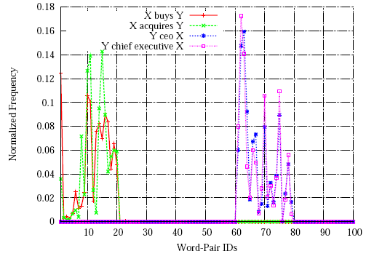
Identifying Relations
Distributional hypothesis: “Words that occur in the same context have similar meanings”
  If two lexical patterns occur within the same set of word pairs, then these two patterns must be similar

Slide 13
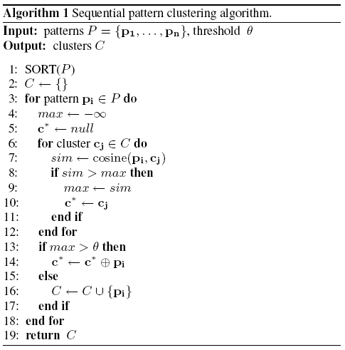
Identifying Relations
Complexity if O(n|C|)
Notes:
SORT: Most frequent patterns first – Ensures most common relations in dataset

Slide 14
Measuring Relational Similarity
Represent each word pair by an N-dimensional feature vector
  N is the total number of clusters
  Feature value: Total frequency of patterns that belong to a cluster
  Feature vectors are normalized to unit length
Learn the Malahanobis distance metric:
  It is able to learn from a few data points
  There are efficient algorithms that can scale well to high-dimensional spaces
Notes:
Accounts inter-dependence between semantic relations

Slide 15
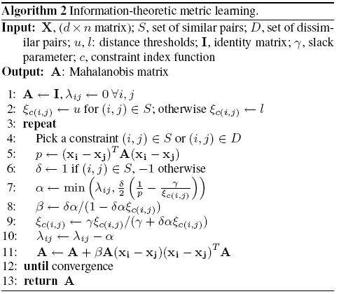
Measuring Relational Similarity
Information Theoretic Metric Learning algorithm:
  (Davis et al. 2007)
  No eigenvalue or eigenvector computations are required
  Scalable to large datasets

Slide 16
Experiments

Slide 17
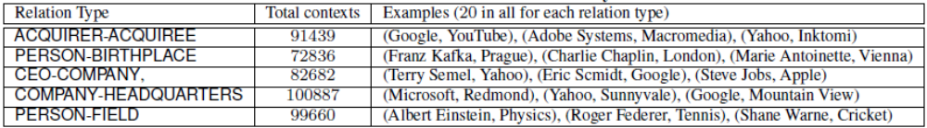
Relation Classification
Classification of semantic relations between named entities (multi-class classification problem)
20 instances of each 5 types
68.64% of the patterns occurs only once (misspellings or badly formatted text)

Slide 18
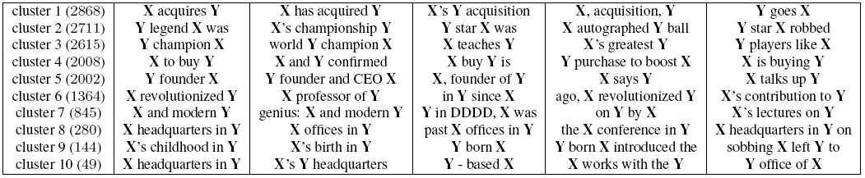
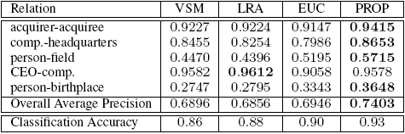
Relation Classification
Most frequent patterns in the 10 largest clusters
Performance of the proposed method and baselines

Slide 19
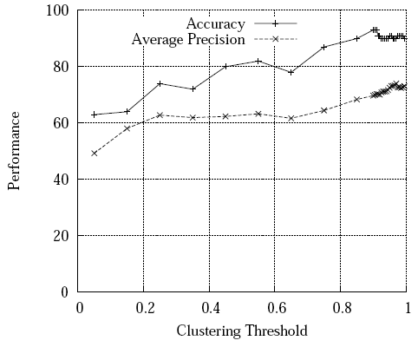
Relation Classification
Clustering threshold x Performance

Slide 20
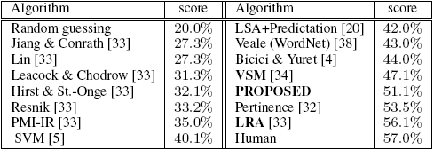
SAT Word-Analogy Questions
374 multiple choice questions
Performance on the SAT dataset
Both Pertinence and LRA use synonym dictionaries
Proposed method takes 6 hours (compared to LRA's 9 days), and requires only two search engine queries

Slide 21
Conclusion

Slide 22
Conclusion
Contributions
  Propose a shallow lexical pattern-based approach to represent various semantic relations
  Present a clustering algorithm to cluster lexical patterns
  Evaluate the proposed method in two tasks
Future Work
  Employ the proposed similarity measure to retrieve a set of word pairs for a given implicit relation from the Web

Slide 23
Thank you!

